Slide 1

Runcible
The Governance Layer for trustworthy AI
This Presentation is designed for the Business and Investor Audience.
For our Deep Dive presentation, white papers, or our library of articles (the rabbit hole) necessary for due diligence or deep understanding, Please ask.
Notes:
Speaker Notes:
“Let me start with the essence: the industry built LLMs as assistants; we built the governance layer they actually need.
Our focus is not convenience — it’s responsibility.
Runcible formalizes decidability, truth, reciprocity, operational possibility, and liability into a computable grammar that can govern any foundation model.
This is the institutional layer for AI.”

Slide 2
Who We Are:
In 2012 we founded a number of organizations with the goal to modernize business, industry, and government..
We operate a privately funded think tank The Natural Law Institute (US, Ukraine) working in scientific, logical, constitutional, legal decidability and it’s reduction to computability.
We have built Reality by Chanting Ltd (UK) that Produces an AI first operating system (platform). The platform requires the AI.
We have founded Runcible Inc to produce the AI necessary for the platform.
We are transferring rights and assets from these organizations into Runcible Inc.
But we find no value in competing for capital necessary to produce our own LLM. Instead, our work has universal application for all foundation models, and we fear that without our work in reaching revenue-producing markets, that the funding of these models will collapse.
By solving the problem of foundation models, our mission both commercial, social, and political is accelerated at a speed our research and product alone cannot achieve.

Slide 3
Executive Summary
We have solved the problem of AI governance.
Our governance layer constrains AI outputs to those that are testable, truthful, reciprocal, and operationally possible — outcomes that are certifiable, auditable, and warrantable.
These outputs can be further constrained to satisfy the demands of law, safety, and alignment within any regulated or institutional context.
By doing so, we end the risk of accidental rogue behavior, replace blind statistical correlation with responsible computation, and give AI a conscience — the capacity for decidable judgment under law.
This enables entry into high-liability markets such as defense, government, and healthcare — where certification, auditability, and warranty are prerequisites for deployment.
And in doing so, we have made AI profitable through responsibility.

Slide 4
Executive Summary
“We didn’t build our own AI,
we built a governance layer
for all AIs.”

Slide 5
The Problem
LLMs are probabilistic authors, not accountable decision engines.
  They produce correlated language, not decidable outputs.
  They lack auditability, guarantees, provenance, and liability.
  Current governance is ex post (filters, heuristics), not procedural.
  No AI lab has solved the core epistemic failure:
  LLMs cannot distinguish True / False / Undecidable.
This blocks enterprise and government adoption in all high-stakes domains. The only domains where revenue can compensate for investment.
Notes:
Speaker Notes:
We have funded the seed stage of research and development ourselves. We need to scale the workforce to bring it to market.
– We lock down the governance layer.
– We stabilize the protocols
– We run our first certifications.
– We integrate with 1–2 verticals.
In the next round:
– We commercialize across foundation models.
– We enter government, defense, medical, and insurance channels.
– We build certification standards that become industry norms.
– We expand globally into every high-liability vertical.
This is the path by which Runcible becomes the default governance layer for AI.”

Slide 6
The Problem: The Correlation Trap
AI is trapped in the “probabilistic suggestion economy.”
Every LLM company sells recommendations, not decisions—because no system today can prove its own correctness, legality, or liability.
The industry is attempting to solve this problem with data. And it’s not working. We call this the “Correlation Trap“.
Worse, the industry promotes mathematical and programmatic achievements despite that they rely on internal closure, which is the simplest domain of computation, instead of the meaningful domains that require external closure.
The addressable market is every domain where errors carry cost or risk—law, finance, healthcare, defense, and governance—representing >$100 T in regulated decision value.
Notes:
Speaker Notes:
We have funded the seed stage of research and development ourselves. We need to scale the workforce to bring it to market.
– We lock down the governance layer.
– We stabilize the protocols
– We run our first certifications.
– We integrate with 1–2 verticals.
In the next round:
– We commercialize across foundation models.
– We enter government, defense, medical, and insurance channels.
– We build certification standards that become industry norms.
– We expand globally into every high-liability vertical.
This is the path by which Runcible becomes the default governance layer for AI.”

Slide 7
The Problem: Available Business Models
Consumer AI: Attention monetization; low liability.
Media AI: Curation of media and social media.
Enterprise AI: Workflow acceleration; productivity pricing.
Governed AI (Runcible): Truth-constrained intelligence; certification and warranty pricing.
Runcible enables machine decidability and warrantability—decisions you can insure, not just review.
“Safety” can provide enterprise employees with general knowledge, but only Runcible can provide enterprises with certification they can warranty.
Notes:
Speaker Notes:
We have funded the seed stage of research and development ourselves. We need to scale the workforce to bring it to market.
– We lock down the governance layer.
– We stabilize the protocols
– We run our first certifications.
– We integrate with 1–2 verticals.
In the next round:
– We commercialize across foundation models.
– We enter government, defense, medical, and insurance channels.
– We build certification standards that become industry norms.
– We expand globally into every high-liability vertical.
This is the path by which Runcible becomes the default governance layer for AI.”

Slide 8
The Problem: Blocking Factors
Epistemic: Correlation ≠ Truth → No decidability.
Technical: Hallucination, indeterminism, no systemic constraint→ No reliability.
Economic: Liability exclusion → No entry into high-risk markets.
Moral: No standard of truth, reciprocity, or accountability.
Notes:
Speaker Notes:
We have funded the seed stage of research and development ourselves. We need to scale the workforce to bring it to market.
– We lock down the governance layer.
– We stabilize the protocols
– We run our first certifications.
– We integrate with 1–2 verticals.
In the next round:
– We commercialize across foundation models.
– We enter government, defense, medical, and insurance channels.
– We build certification standards that become industry norms.
– We expand globally into every high-liability vertical.
This is the path by which Runcible becomes the default governance layer for AI.”

Slide 9
Market Imperative
The largest sectors cannot deploy LLMs without a governance layer:
  Law & Regulation – statute interpretation, compliance, contracting
  Communications, Media, and Social Media - Curation
  Healthcare – diagnostics, clinical reasoning, FDA-bound systems
  Finance – risk, credit, insurance, actuarial, audit
  Defense/Intel – intelligence analysis, procurement, mission planning
  Government & Enterprise Ops – procurement, oversight, workflows
These sectors demand:
  Provable correctness within scope
  Adversarially robust reasoning
  Liability-compatible audit trails
  Operational warranty
This is precisely what Runcible provides.
Notes:
Speaker Notes:
We have funded the seed stage of research and development ourselves. We need to scale the workforce to bring it to market.
– We lock down the governance layer.
– We stabilize the protocols
– We run our first certifications.
– We integrate with 1–2 verticals.
In the next round:
– We commercialize across foundation models.
– We enter government, defense, medical, and insurance channels.
– We build certification standards that become industry norms.
– We expand globally into every high-liability vertical.
This is the path by which Runcible becomes the default governance layer for AI.”

Slide 10
Why Existing AI Cannot Satisfy Revenue Producing Markets
Structural limitations of current LLMs:
  They perform next-token correlation, not causal reasoning.
  They cannot guarantee non-deception or non-omission.
  They lack global constraints on inference paths.
  They cannot produce operational restatements or decidable outputs.
  They cannot expose internal uncertainty or unresolvable ambiguity.
Regulators, insurers, and courts simply cannot accept this paradigm.
Notes:
Speaker Notes:
We have funded the seed stage of research and development ourselves. We need to scale the workforce to bring it to market.
– We lock down the governance layer.
– We stabilize the protocols
– We run our first certifications.
– We integrate with 1–2 verticals.
In the next round:
– We commercialize across foundation models.
– We enter government, defense, medical, and insurance channels.
– We build certification standards that become industry norms.
– We expand globally into every high-liability vertical.
This is the path by which Runcible becomes the default governance layer for AI.”

Slide 11
The Solution to the Blocking Problems
Runcible adds the Governance Layer:
(Governance < Constraint < Closure < Decidability < Judgement < Warranty)
Causal grounding replaces statistical correlation.
Governance constrains every inference.
Protocols test possibility, harm, truth, and warrant.
Ledgered outputs provide audit, warranty, and liability.
Certified outputs re-train the LLM into convergence on truth.
This transforms AI from “suggestive assistant” → Decidable Intelligence System.
Notes:
Speaker Notes:
We have funded the seed stage of research and development ourselves. We need to scale the workforce to bring it to market.
– We lock down the governance layer.
– We stabilize the protocols
– We run our first certifications.
– We integrate with 1–2 verticals.
In the next round:
– We commercialize across foundation models.
– We enter government, defense, medical, and insurance channels.
– We build certification standards that become industry norms.
– We expand globally into every high-liability vertical.
This is the path by which Runcible becomes the default governance layer for AI.”

Slide 12
Enterprise AI Value Chain
Category | Enterprise Benefit
Governance | Ensures AI remains controllable, accountable, and aligned with organizational and legal constraints.
Safety | Reduces exposure to harms, errors, and systemic externalities from AI-assisted decisions.
Compliance | Enables legal deployability and smooth audits by conforming to laws, regulations, and internal controls.
Liability | Clarifies who is responsible for which outcomes, stabilizing operations and risk management.
Warranty / Trust | Allows reliance on AI outputs in workflows without constant human double-checking.
Verification | Eliminates hallucinations and reduces mission-critical error rates through evidence-backed outputs.
Production | Delivers actionable work products that replace or accelerate manual knowledge work.
Insight | Improves strategic and operational decisions by highlighting what matters and reducing cognitive load.
Understanding | Ensures outputs match intent by correctly interpreting tasks, constraints, and context.
Structure | Standardizes AI behavior across teams through templates, workflows, and consistent patterns.
Creativity | Expands the option set, supporting innovation, reframing of problems, and exploratory analysis.
Notes:
Speaker Notes:
We have funded the seed stage of research and development ourselves. We need to scale the workforce to bring it to market.
– We lock down the governance layer.
– We stabilize the protocols
– We run our first certifications.
– We integrate with 1–2 verticals.
In the next round:
– We commercialize across foundation models.
– We enter government, defense, medical, and insurance channels.
– We build certification standards that become industry norms.
– We expand globally into every high-liability vertical.
This is the path by which Runcible becomes the default governance layer for AI.”

Slide 13
The Enterprise AI Value Funnel
┌─────────────────────────────────────────────────────────┐
│ Creativity │
└─────────────────────────────────────────────────────────┘
▼
┌─────────────────────────────────────────────────────┐
│ Structure │
└─────────────────────────────────────────────────────┘
▼
┌─────────────────────────────────────────────────┐
│ Understanding │
└─────────────────────────────────────────────────┘
▼
┌───────────────────────────────────────────────┐
│ Insight │
└───────────────────────────────────────────────┘
▼
┌───────────────────────────────────────────┐
│ Production │
└───────────────────────────────────────────┘
▼
┌───────────────────────────────────────┐
│ Verification │
└───────────────────────────────────────┘
▼
┌───────────────────────────────────┐
│ Trust / Warranty │
└───────────────────────────────────┘
▼
┌───────────────────────────────┐
│ Liability │
└───────────────────────────────┘
▼
┌───────────────────────────┐
│ Compliance │
└───────────────────────────┘
▼
┌───────────────────────┐
│ Safety │
└───────────────────────┘
▼
===============================================
THE EXISTING LLM NATIVE FUNCTIONALITY
Creativity Layer
Opportunity Generation
===============================================
THE NEW GOVERNANCE LAYER FUNCTIONALITY
Constraint Layer
The control system enabling deployment in reality
Revenue Production

Slide 14
Runcible is a Category Creator
Runcible does not compete with OpenAI, Google,
Anthropic, or xAI - It completes them.
Foundation models remain probabilistic text engines.
Runcible becomes the regulatory, liability, and audit layer required for:
  Medical-grade AI
  Legal-grade AI
  Enterprise-grade AI
  Government-grade AI
  Military-grade AI
This makes Runcible the choke point for safe, warrantable AI adoption.
Notes:
Speaker Notes:
We have funded the seed stage of research and development ourselves. We need to scale the workforce to bring it to market.
– We lock down the governance layer.
– We stabilize the protocols
– We run our first certifications.
– We integrate with 1–2 verticals.
In the next round:
– We commercialize across foundation models.
– We enter government, defense, medical, and insurance channels.
– We build certification standards that become industry norms.
– We expand globally into every high-liability vertical.
This is the path by which Runcible becomes the default governance layer for AI.”

Slide 15
What We Have Done and Invested So Far
13 years of scientific groundwork at Natural Law Institute.
Oversing, the first AI-First Universal Application Platform (~Operating System) fully integrated with AI. 1M lines of code, (Demo available)
Fully specified governance architecture (Truth / Reciprocity / Liability).
Prototype governance engine validated on GPT-class models.
Self-funded ~$10M through development—no external dilution yet other than a few friends and family SAFE agreements
Demos Available: Runcible Governance Layer, Oversing Platform
Notes:
Speaker Notes:
We have funded the seed stage of research and development ourselves. We need to scale the workforce to bring it to market.
– We lock down the governance layer.
– We stabilize the protocols
– We run our first certifications.
– We integrate with 1–2 verticals.
In the next round:
– We commercialize across foundation models.
– We enter government, defense, medical, and insurance channels.
– We build certification standards that become industry norms.
– We expand globally into every high-liability vertical.
This is the path by which Runcible becomes the default governance layer for AI.”

Slide 16
One Law: Continuous Recursive Disambiguation
Universe Under Pressure
Evolutionary Computation: the continuous recursive
disambiguation (CRD( of entropy into order: persistence, identity.
Universal Grammar: the continuous recursive disambiguation (CRD)
of entropy ambiguity into order identity, meaning.
Domain Grammars: Rules of continuous recursive disambiguation (CRD)
within a paradigm consisting of dimensions of permissible
measurement, vocabulary as measures of identities and
operations and states, And resulting logical possibilities of
changes in state.
Methodology:
- Language (Referents): Continuous recursive
disambiguation (CRD) of ambiguity into identity and into index (positional
relation), meaning: Measurements.
- Principles (Laws, Logic): Same process (CRD) for reduction to causality.
Meta-Grammar: Result: Subjectively and objectively testable identities
and operations – falsification by constructive logic – just like geometry.
Books: Crisis, Language, Logic, Science, Law (Ethics), History, Humanities
Training: Training Modules from the books
Code: Governance layer for LLMs enforcing constraint and closure.
TCL: Continuous recursive disambiguation of memories (data) into truths.
Evolutionary Computation
Human Language Faculty
Universal Grammar
Human Languages
Spectrum of Domain Grammars
Methodology
Meta Grammar
Books
Training
Code
Neural Network

Slide 17
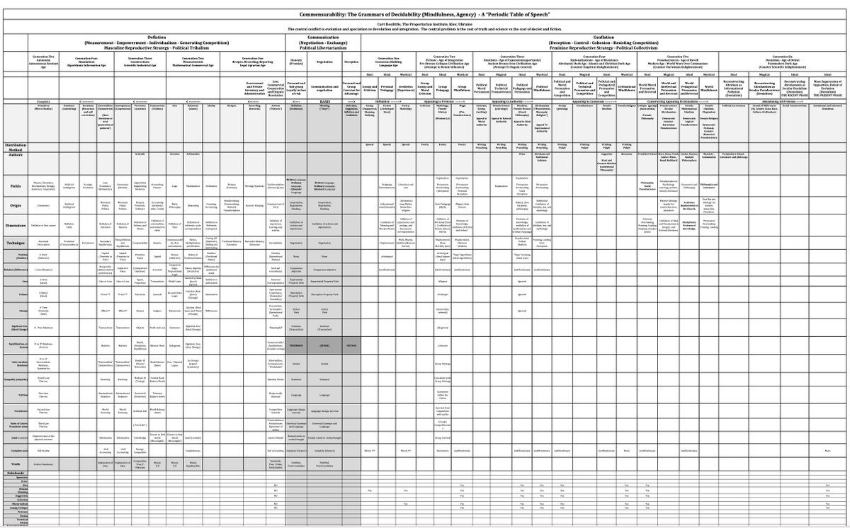
The ‘Periodic Table’ of Grammars

Slide 18

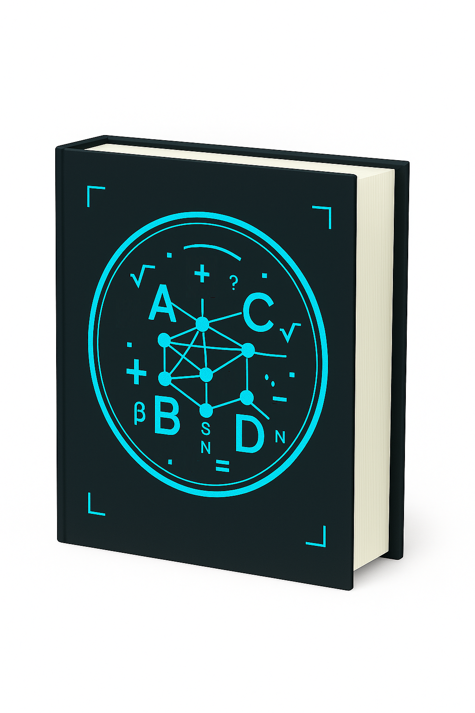
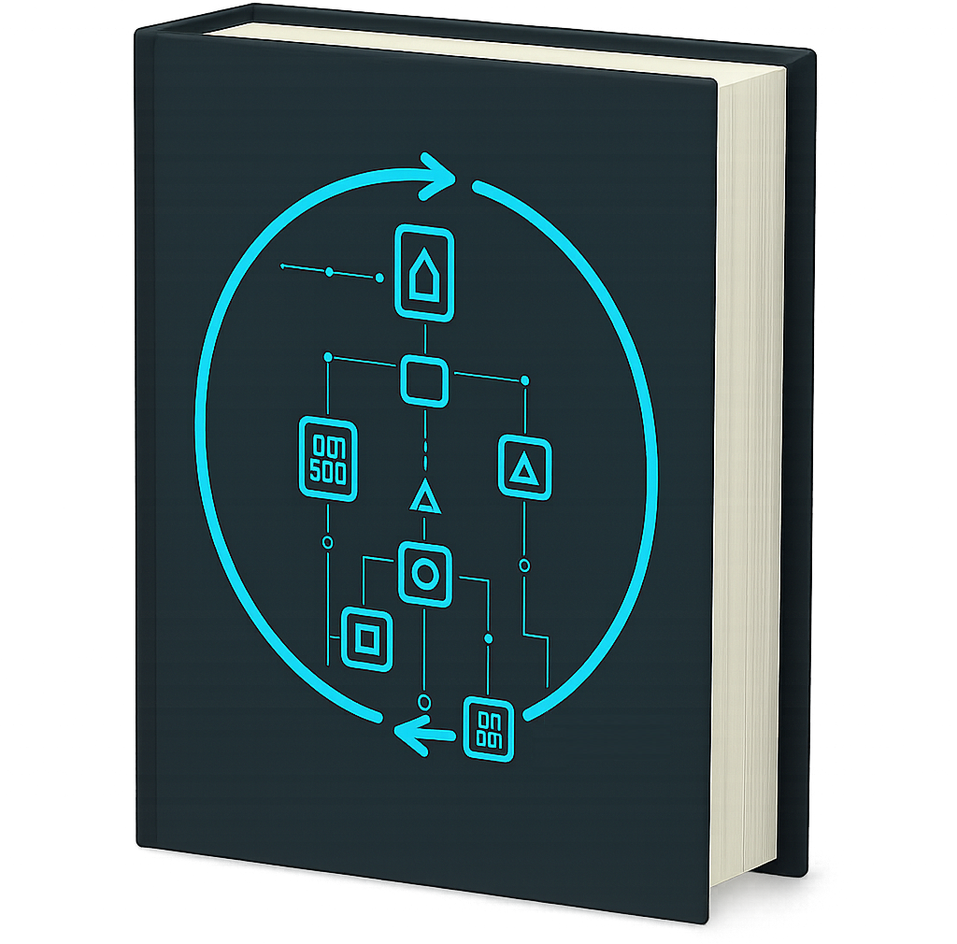

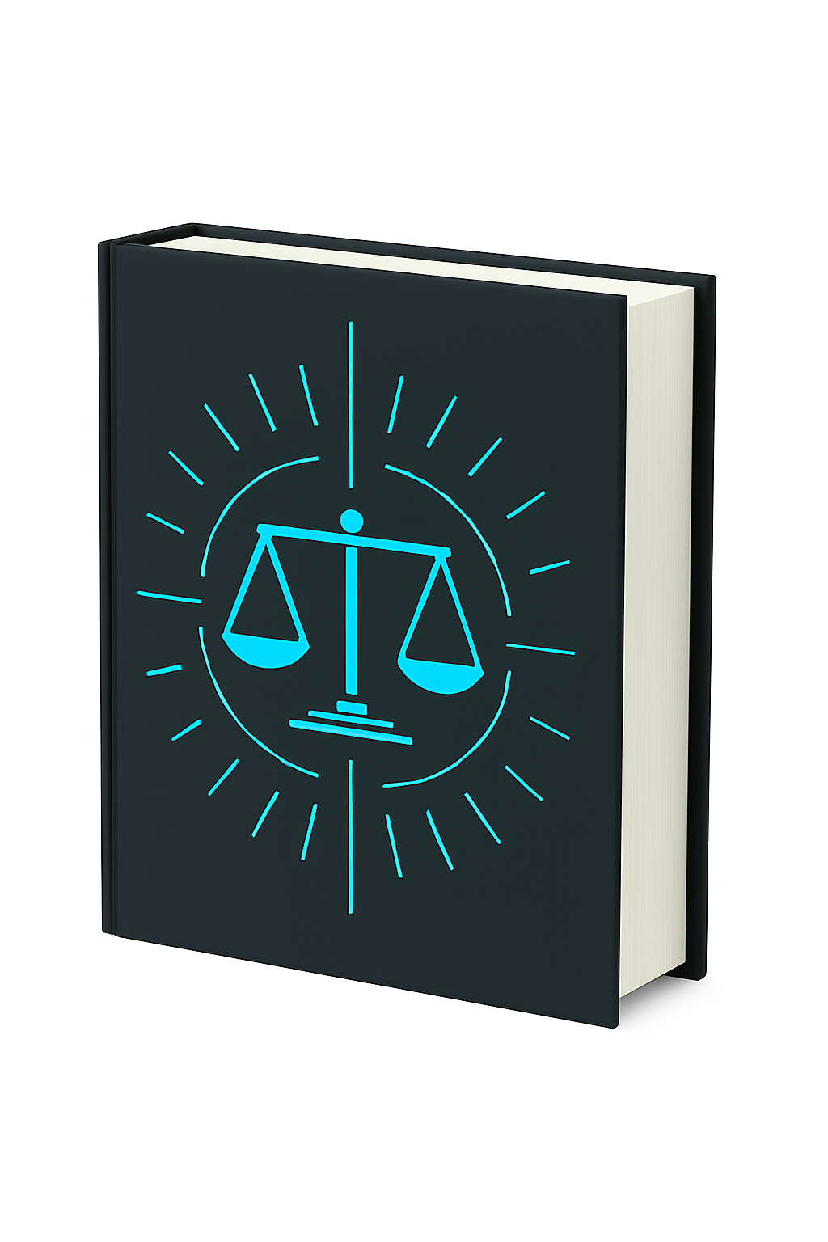


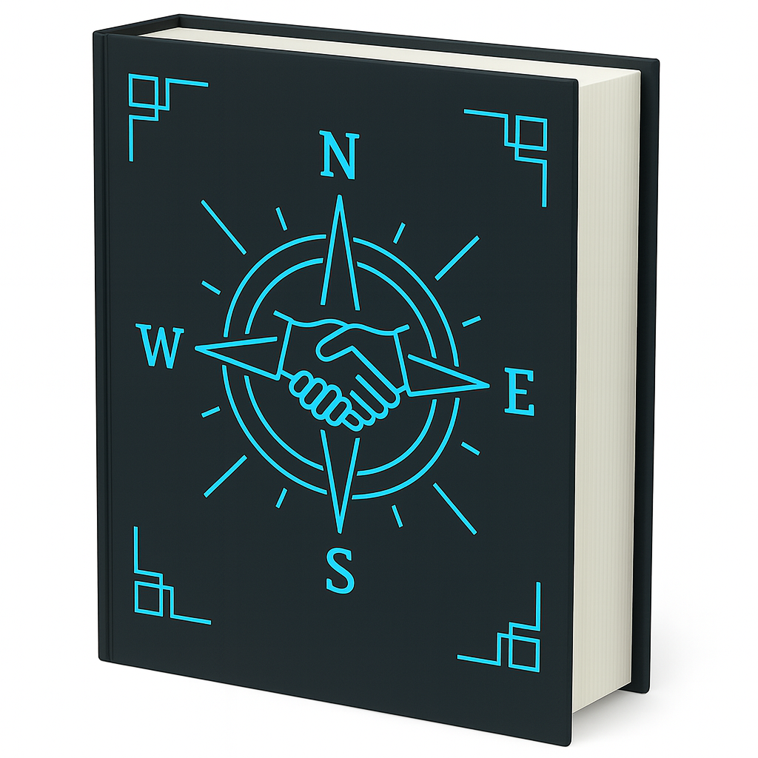
Results of Our Research: The Science and Logic of Computability
The Crisis of the Age – The cause and cure of fall of civilizations (70%)(~1500pp)
Language (as a System of Measurement) – The Foundation (99%) (~500pp)
Logic – The logic of evolutionary computation at all scales (60%) (~500pp)
Science (of Behavior) – How people behave, cooperate, and organize (~1500pp)
Law – The natural law of cooperation and its implementation (50%) (~1200pp)
History – Evolution and different patterns of adaptation (60%) (~600pp)
Religion - The rules of group strategy through narrative (10%) (~400pp)
Humanities – Evolution of group strategy in literary form (5%) (~600pp)

Slide 19
The Roadmap
Research (Complete)
The Volumes (Foundation)
Crisis
Language
Logic
Science
Law
History
Humanities
< completeness >
The Code (from Volumes)
It’s a hierarchical sequence. And so the abilities
of the AI increase dramatically with every
asset we produce, and, the AI accelerates the
production of each asset in the sequence.
Training (from Volumes)
Markets (Applied and Revenue – Machine producible, human auditable, > Code > Training )
Military
Government
Reg. Compliance
Medicine
Finance
Enterprise
Stakes Edu.
Sci./Eng.
Notes:
Speaker Notes:
We have funded the seed stage of research and development ourselves. We need to scale the workforce to bring it to market.
– We lock down the governance layer.
– We stabilize the protocols
– We run our first certifications.
– We integrate with 1–2 verticals.
In the next round:
– We commercialize across foundation models.
– We enter government, defense, medical, and insurance channels.
– We build certification standards that become industry norms.
– We expand globally into every high-liability vertical.
This is the path by which Runcible becomes the default governance layer for AI.”

Slide 20
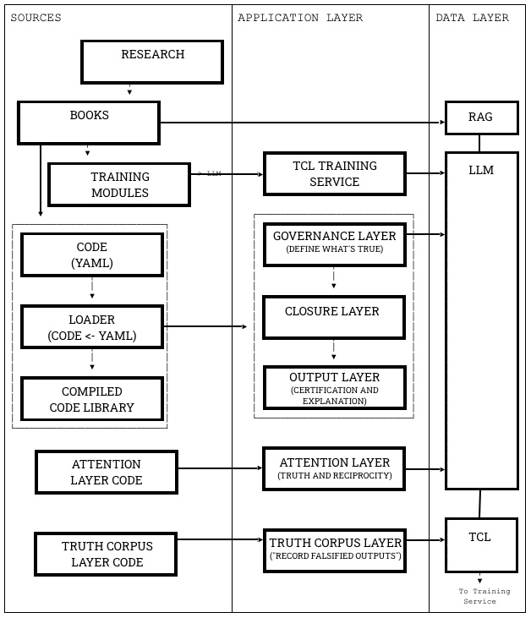
Architecture
Four-Layer Governance Engine:
Governance Layer (constraints)
Decidability + Truth + Reciprocity + Liability
Closure Layer (procedural enforcement)
Serializes reasoning, enforces steps, logs telemetry
Truth Corpus Layer
Verified domain knowledge; eliminates hallucination sources
Attention Layer
Controls LLM access; constrains inference pathways
Result: deterministic, auditable outputs from stochastic LLM cores.
Notes:
Speaker Notes:
We have funded the seed stage of research and development ourselves. We need to scale the workforce to bring it to market.
– We lock down the governance layer.
– We stabilize the protocols
– We run our first certifications.
– We integrate with 1–2 verticals.
In the next round:
– We commercialize across foundation models.
– We enter government, defense, medical, and insurance channels.
– We build certification standards that become industry norms.
– We expand globally into every high-liability vertical.
This is the path by which Runcible becomes the default governance layer for AI.”

Slide 21
Revenue Model
Licensing • Curation • Certification • Compliance Engines
• Vertical Integrations
  Licensing to foundation model providers
  SaaS governance layer
  Curation of Social Media
  Curation of Media and Communications
  Per seat or Enterprise Licensing
  Certification for high-liability institutions
  Compliance engines and risk infrastructure
  Vertical integrations (defense, gov, med, finance, insurance)
Notes:
Speaker Notes:
Our business model is simple and scalable:
We license the governance layer to every frontier model provider who wants access to high-liability markets.
We certify outputs the way auditors certify financials.
We provide compliance engines to government, defense, insurance, and critical infrastructure.
We integrate vertically with institutions whose risk exposure is enormous.
This yields enterprise-scale revenue with extremely high switching costs.

Slide 22
Estimated WW Value of Known Markets
Sector / Function | US Market | EU Market | Global Market | Runcible Replacement
News & Journalism (traditional + digital) | $120B | $100B | $250B+ | Runcible News, Segment Index, Brand API
Public Education (K–12 Civics, Higher Ed Reasoning) | $700B+ | $600B+ | $2.5T+ | Runcible Education
Civic Tech & Government Transparency | $3B | $2.5B | $10B | Public Record, Civic Mirror, Integrity Suite
Political Polling & Consulting | $3B | $2B | $6B | TruthPulse, Segment Index
Campaign Management Tools | $15B | $10B | $40B+ | Campaign Coach, Advocacy Engine
Government Economic Reporting (BLS, Fed, ECB, IMF) | $2B | $2B | $6B+ | Runcible Economic Indicators Reporting
Legislative & Policy Analysis | $10B | $10B | $30B | Legislative Ledger, Constitutional Simulator
Military Intelligence / Strategic Modeling | $100B+ (DoD) | $50B+ (EU/NATO) | $300B+ globally | Runcible Strategic Intelligence
Self-Help / Coaching / Assessment Industry | $40B | $25B | $80B | Runcible Self, Relationship Mirror, Employer Index
Human Capital & Hiring Platforms | $30B | $20B | $100B+ | Employer Index
Fact-Checking & NGO Watchdogs | ~$1B | ~$1B | ~$4B | Public Record, News, Integrity APIs
Public Advisory & Think Tank Sector | $1.5B | $2B | $6B | Legislative Ledger, Strategic Intel
Creating A Market for Truth
U.S., Europe, and Global Estimates (Annualized)
Every number we come up with is so large
It’s meaningless.
A $500B+ wedge market (U.S./EU)
A $1.5T+ global replacement opportunity
The ability to monopolize truth trustworthiness at scale, without partisan allegiance or institutional capture
Notes:
Speaker Notes:
Our business model is simple and scalable:
We license the governance layer to every frontier model provider who wants access to high-liability markets.
We certify outputs the way auditors certify financials.
We provide compliance engines to government, defense, insurance, and critical infrastructure.
We integrate vertically with institutions whose risk exposure is enormous.
This yields enterprise-scale revenue with extremely high switching costs.

Slide 23
Comparison
Example:
What Palantir does by finding value in big data we do with reasoning and certifying the truth, ethics, possibility, and liability of claims. That’s the best comparison. We search for and codify rules that are compatible with the hierarchy of laws, and reduce knowledge domains to tests of computability, testifiabililty, constructability, or what we think of as possibility. Runcible is compatible, not competitive with Palantir. Just as our work with LLMs is compatible and enriching not competitive.

Slide 24
What Remains to Be Done to Go to Market
Completion and Conversion of Remaining Volumes
Productization of the Governance Layer and SDK
Integration with one or more major LLM partners (OpenAI, xAI, Microsoft, Amazon AWS, Anthropic).
Truth Corpus Production (verified data pipeline).
Legal framework for certified and warrantied AI outputs.
Targeted pilot deployments in Medicine, law, finance, and defense.
  (We have identified and are in discussions with a medical candidate.)
(This is far easier than what we have done for the US military and their logistical operations in the past.)
Notes:
Speaker Notes:
We have funded the seed stage of research and development ourselves. We need to scale the workforce to bring it to market.
– We lock down the governance layer.
– We stabilize the protocols
– We run our first certifications.
– We integrate with 1–2 verticals.
In the next round:
– We commercialize across foundation models.
– We enter government, defense, medical, and insurance channels.
– We build certification standards that become industry norms.
– We expand globally into every high-liability vertical.
This is the path by which Runcible becomes the default governance layer for AI.”

Slide 25
Domain Expansion: Methodology Analysts
Experts in Runcible’s methodology to extract domain reasoning and distill it into first principles and natural law
Conduct precision interviews to surface institutional logic, compliance heuristics, and latent decision structures for continuous tuning of
Translate inputs into modular, auditable logic expanding Runcible’s universal governance layer
Many with over a decade of experience researching and shaping the core architecture
Ensure every contribution is defensible, interoperable, and aligned with enterprise-grade intelligence
Interpretive engine tuning Runcible’s evolving Meta Grammar
We cannot, nor can anyone else, hire ‘people off the street’ to do this work. We can hire people from consulting backgrounds with experience in various domains of analysis of business processes and decision making. But they will learn primarily from working with Runcible because it ‘knows’ its methodology and how to apply it.

Slide 26
Defensibility
What we do is very, very hard. Without giving
A presentation in the history of thought: In logic
it is the equivalent of Newton in the Calculus,
Darwin in Biology or Watson/Crick in Genetics.
But once understood, like the periodic table,
the explanatory power and utility is endless.
And it turns out that the weakness of LLMs outside
of internal closure (ideals), is of supra-human utility
In fields of external closure: reality (reals).

Slide 27
Defensibility
Governance < Constraint < Closure < Decidability < Judgement
in externally closed domains (the real world, not math, not programming.)
Strongest moat in the AI ecosystem:
  40+ years of formal epistemology, natural law, operational logic
  Proprietary protocols, decidability tests, closure layers
  Domain-specific truth corpora
  Regulatory advantage: courts and agencies will require this layer
  First-mover advantage in the only unsolved problem:
  how to make AI accountable
LLMs will commoditize; Runcible's governance will not.
Notes:
Speaker Notes:
We have funded the seed stage of research and development ourselves. We need to scale the workforce to bring it to market.
– We lock down the governance layer.
– We stabilize the protocols
– We run our first certifications.
– We integrate with 1–2 verticals.
In the next round:
– We commercialize across foundation models.
– We enter government, defense, medical, and insurance channels.
– We build certification standards that become industry norms.
– We expand globally into every high-liability vertical.
This is the path by which Runcible becomes the default governance layer for AI.”

Slide 28
Post-A Round State (Commercialization)
Runcible becomes:
  The governance layer for all high-liability AI
  The certification authority for decision systems
  The licensing layer for every major model provider
  The institutional equivalent of accounting, auditing, and law for AI
This is the only viable business model that makes frontier AI economically sustainable — and we’ve already built it.

Slide 29
Why Runcible Wins
We built the institutional layer others forgot,
couldn’t imagine, or couldn’t solve.
(FWIW: It’s really, really, really, hard.)
  We start from law, science, and adversarialism, not convenience.
  We built the only closure system for machine decidability.
  We provide the legal and epistemic layer they cannot create internally.
  Every frontier model will require this layer to sell into high-liability markets - the only profitable markets.
Notes:
Speaker Notes:
Runcible starts from the opposite end:
We begin with law, truth, cooperation, and liability.
We built the only computable grammar that can govern machine cognition.
Foundation models become interchangeable commodities under our governance layer.
Every frontier model provider will eventually need what we built.
And we built it first — with decades of deep research amortized into protocols and software.

Slide 30
Summary
  Assistant revenue is tens of dollars per user per year.
  High-liability revenue is millions of dollars per deployment.
  Frontier AI costs billions per year. One of these markets can pay for it. The other cannot.
  Convenience markets are shallow; responsibility markets are deep.
  Assistants swim in the shallow pool. Runcible operates in the ocean.
Every technological revolution begins with democratization narratives but matures into infrastructure governed by regulation, liability, and trust. The industry skipped directly to the narrative and forgot the infrastructure. Runcible is the missing infrastructure.
Why? They couldn’t solve the problem of trustworthy output. We can. We did.
Notes:
Speaker Notes:
We have funded the seed stage of research and development ourselves. We need to scale the workforce to bring it to market.
– We lock down the governance layer.
– We stabilize the protocols
– We run our first certifications.
– We integrate with 1–2 verticals.
In the next round:
– We commercialize across foundation models.
– We enter government, defense, medical, and insurance channels.
– We build certification standards that become industry norms.
– We expand globally into every high-liability vertical.
This is the path by which Runcible becomes the default governance layer for AI.”

Slide 31
Vision
We envision a world in which democratic polities, public institutions, and private enterprises operate on a common grammar of truth, reciprocity, and demonstrated interests—supported by legal, economic, and computational systems that make deception unprofitable, conflict unnecessary, and cooperation maximally productive. Our work exists to restore the civic, economic, and legal capacities of free societies by rebuilding the informational and institutional conditions for peaceful, ethical, governance.
Notes:
Speaker Notes:
Runcible starts from the opposite end:
We begin with law, truth, cooperation, and liability.
We built the only computable grammar that can govern machine cognition.
Foundation models become interchangeable commodities under our governance layer.
Every frontier model provider will eventually need what we built.
And we built it first — with decades of deep research amortized into protocols and software.

Slide 32
Management Team
Proven record of successful execution working together for over 20+ years.
Curt Doolittle, CEO: Excel Data, RedTech, Data Dimensions, Ascentium, Natural Law Institute
Dr Bradley Werrell, President, Co-Author of Doolittle’s Volumes
Eric Adams, COO: Lante, Ascentium, Razorfish, Merkle
Ariella Cipra, EVP: Ascentium, Avanade, Bridge Partners
Francis Zhou, Program Management and Test, Microsoft, Google
Luke Weinhagen, Delivery Management, Sr Developer, Author, Lecturer
With Moritz Bierling, Noah Revoy, and others, Authors, Lecturers
Built, bought, and sold multiple companies in the $100M range.
Made the INC 500 list three times and featured in Forrester Wave.
Decades of experience partnering with Microsoft as a vendor and implementation partner.
Clients span startups, mid-market, and Fortune 100 companies.
Top 25 global independent agencies (industries highest customer satisfaction ratings).
Strategy, Branding, Marketing, Business Reorganization by Tech Implementation, Platforms.
Experts in technology, behavioral economics, and strategic execution.
Thousands of implementations per year across the enterprise government and military.
See CurtDoolittle.com

Slide 33
Ask
We have invested $2M of cash from our personal funds, and are bringing ~10M in assets and forgone compensation into Runcible from NLI (research) and Reality by Chanting (product).
We have produced demonstrable assets:
(a) An AI-First Universal software platform consisting of over a million lines of code (”Oversing”) that no one has yet even envisioned,
(b) A Science of Computable Decidability,
(c) A conversion of the science into architecture and code for integration into any LLM.
We are raising a $20–25M Series A to:
  Build domain-specific truth corpora (legal, medical, finance)
  Expand engineering team (protocols, compilers, inference constraints)
  Deliver government and enterprise integrations
  Launch certification and audit products
  Prepare for eventual regulatory standardization
Notes:
Speaker Notes:
We have funded the seed stage of research and development ourselves. We need to scale the workforce to bring it to market.
– We lock down the governance layer.
– We stabilize the protocols
– We run our first certifications.
– We integrate with 1–2 verticals.
In the next round:
– We commercialize across foundation models.
– We enter government, defense, medical, and insurance channels.
– We build certification standards that become industry norms.
– We expand globally into every high-liability vertical.
This is the path by which Runcible becomes the default governance layer for AI.”

Slide 34
Justification
Given:
The volatility of the present AI discourse (noise).
The overinvestment in speculation on the hardware sector in particular (market noise, nVidia, Palantir, Circular Funding).
The upcoming disruption as AI suppresses entry level white collar work (especially women) at the same time as correction.
The threat of general market correction and uncertainty due to international instability.
The accumulating speculative concern that the LLM
producers cannot produce the solution we have with Runcible.
We are confident of early acquisition pressure at high multiples.
We seek three years of runway without the necessity of revisiting funding rounds in temporary periods of chaos.

Slide 35
Call to Action
We aren’t building another assistant.
We’re building the institutional platform of the AI age.
It’s the control layer every AI must have
to enter high-liability markets.
Either you have it. Or you’re left behind.
And we’re the only team on Earth that can deliver it.
Notes:
Speaker Notes:
Let me end on the core message:
We are not building an assistant.
We are building the computable rule of law for machines.
We are building the governance, truth, reciprocity, and liability layer that makes frontier AI sustainable.
Every major model will need this layer.
And no one else is building it.
Runcible is the institutional substrate for the AI age — and the only viable economic solution for frontier AI.

Slide 36
Next Steps
  • Demo the Solution — experience closure logic in action.
  • Review the Technical White Paper — explore the architectural moat.
  • Access the Investor Portal — market, business, and technology deep dives.
  • Schedule a Follow-Up Discussion — engage the founding team.
Series A Opportunity:
We’re opening strategic Series A partnerships to scale Runcible as the governance and reasoning standard for enterprise and AGI infrastructure.
Runcible Investor Portal

Slide 37
Contact
If we inspired your interest, ask us for our:
Deep dive presentation.
Architectural White Paper.
Long form Leave Behind (100pp)
“How it Works” Paper
Live Demo of our Runcible Governance Layer
curt.doolittle@runcible.com
ariella.cipra@runcible.com
moritzbierling@hey.com
www.runcible.com
Notes:
Speaker Notes:
Let me end on the core message:
We are not building an assistant.
We are building the computable rule of law for machines.
We are building the governance, truth, reciprocity, and liability layer that makes frontier AI sustainable.
Every major model will need this layer.
And no one else is building it.
Runcible is the institutional substrate for the AI age — and the only viable economic solution for frontier AI.

